Slide 1
How to use PowerPoint
Ms. Lowe

Slide 2
How to add Text
If you want to add text to a slide, click Insert at the top of the page.

Slide 3
How to add Text
Click “Text Box”

Slide 4
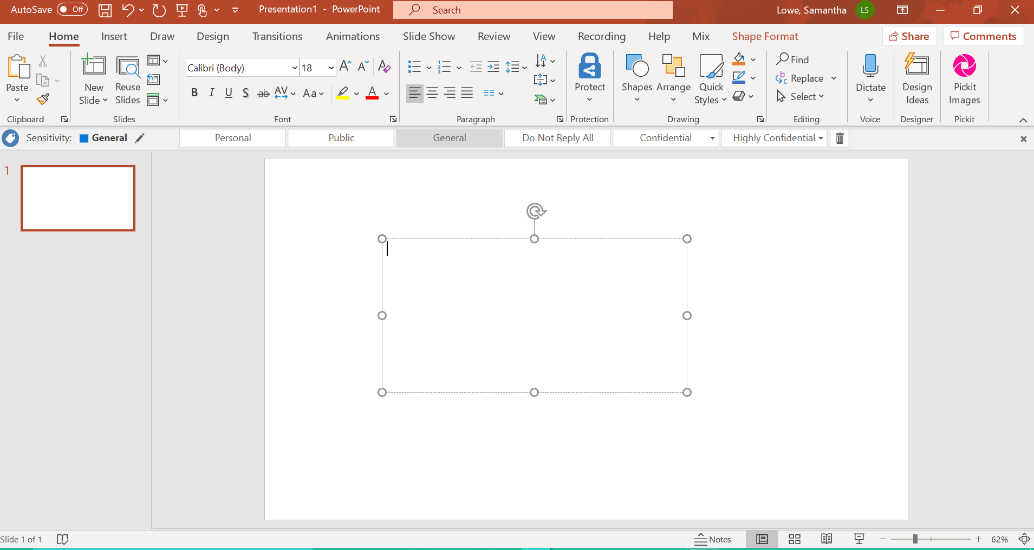
How to add Text
It will either create a text box for you, OR your arrow will change shape and you can click on the PowerPoint and drag the mouse across the screen to create a text box.

Slide 5
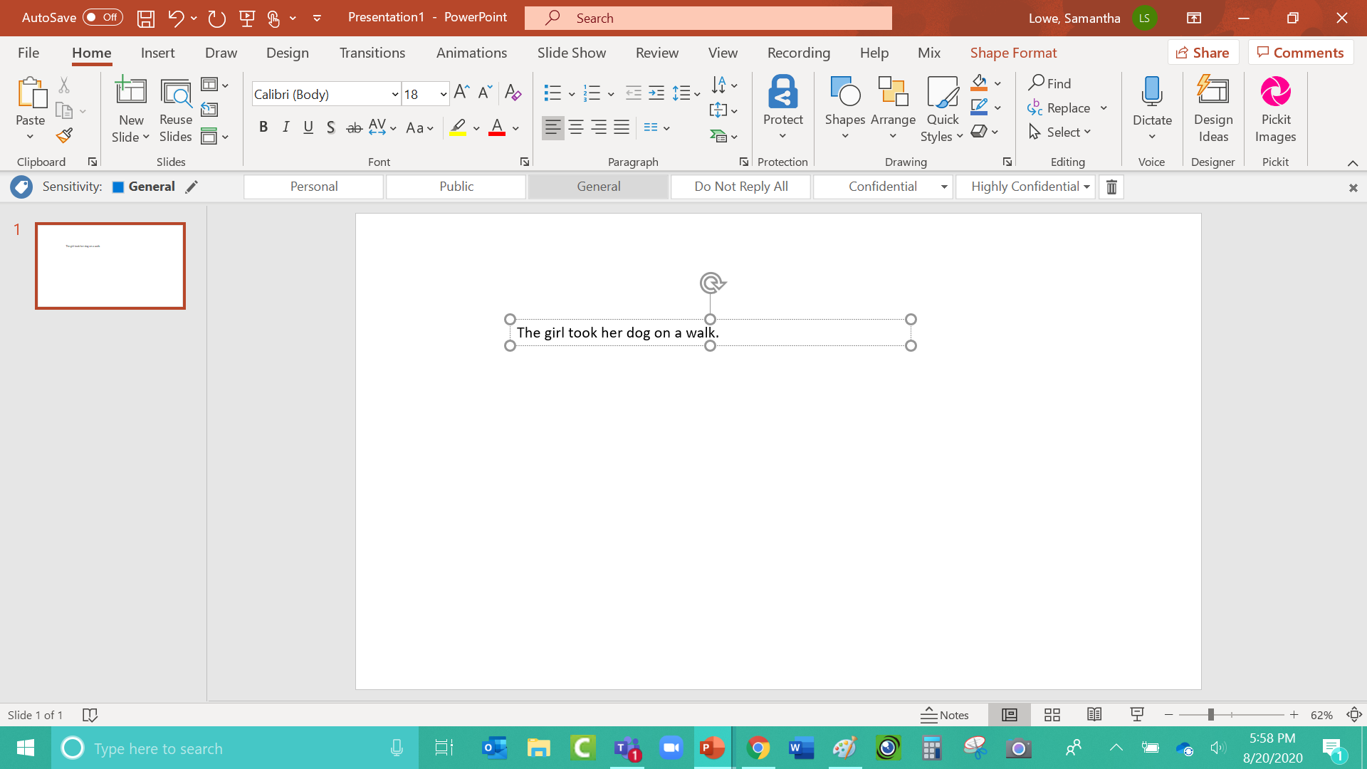
How to add Text
Once you type your text, you can make it bigger or smaller.

Slide 6
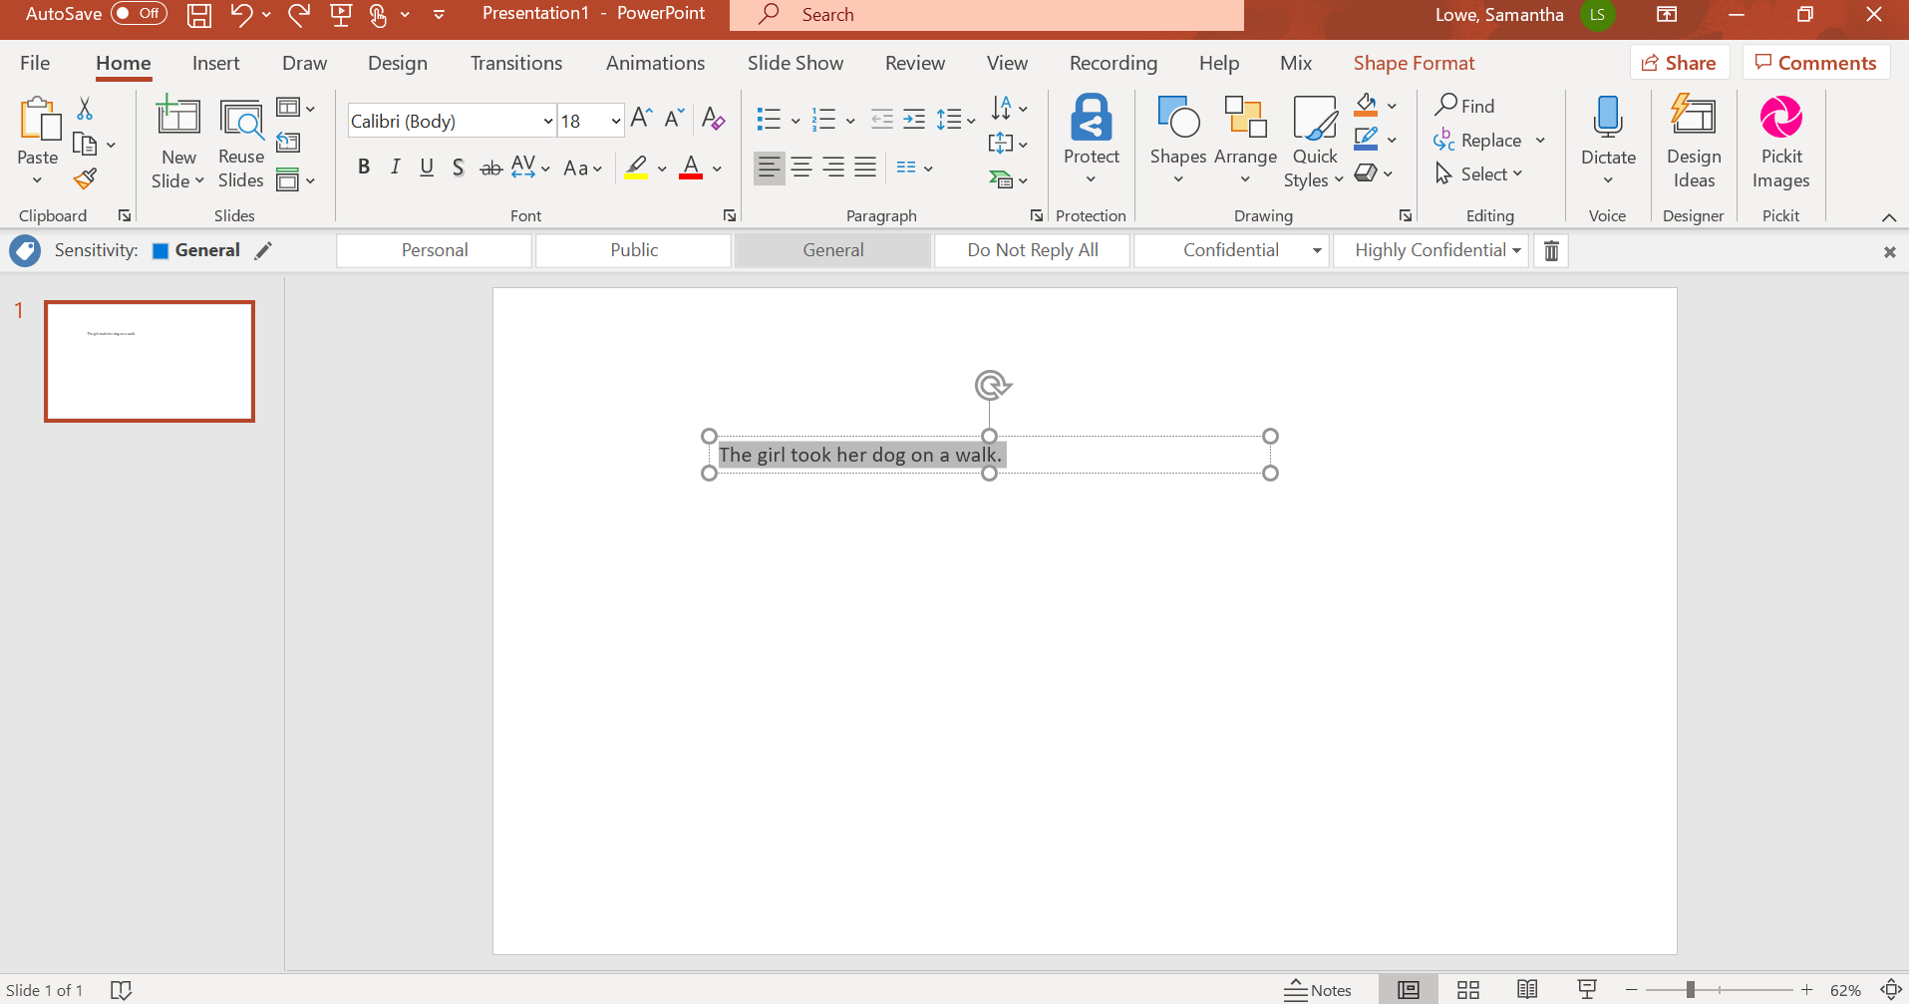
How to add Text
Either click on one word in the sentence three times quickly, OR click at the beginning of the sentence, hold the mouse down, and drag your mouse over the entire sentence.

Slide 7
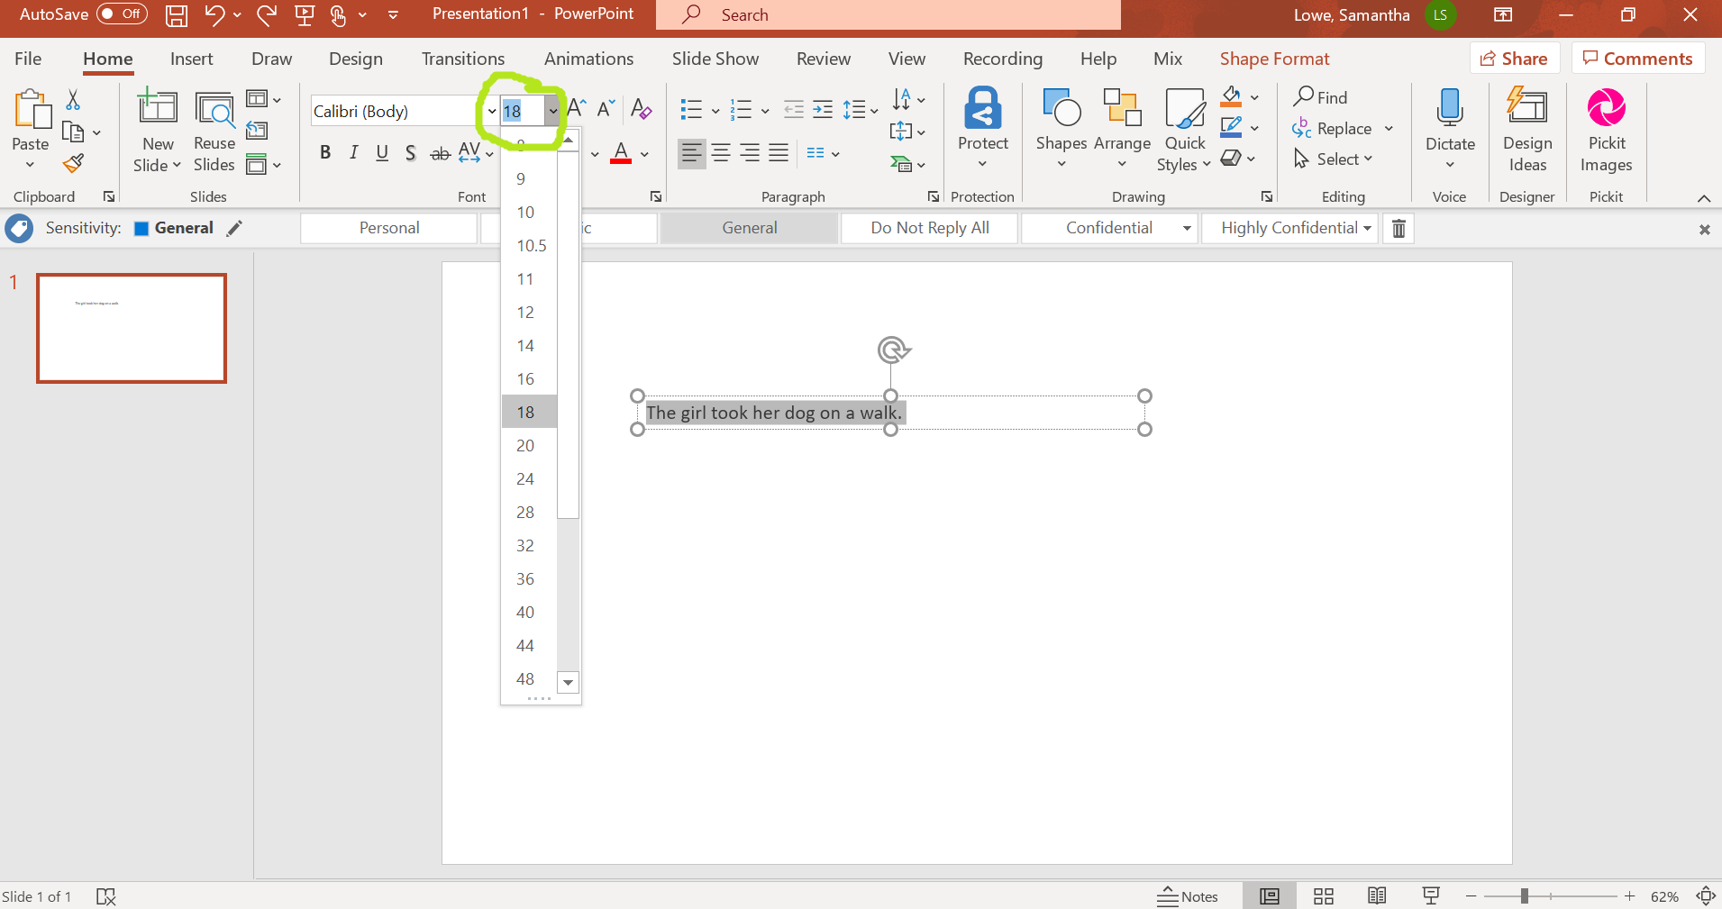
How to add Text
Make sure you are on the “Home” tab and you can change the font size. Press the arrow next to the number and change it to a bigger or smaller font size.

Slide 8
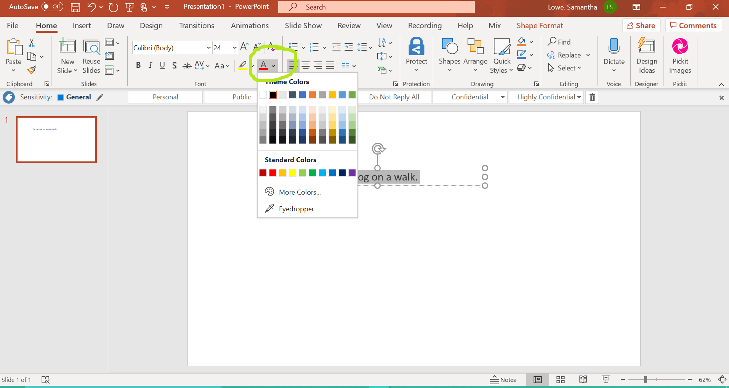
How to add Text
You can also change the color of the font by pressing the button circled in the picture.

Slide 9
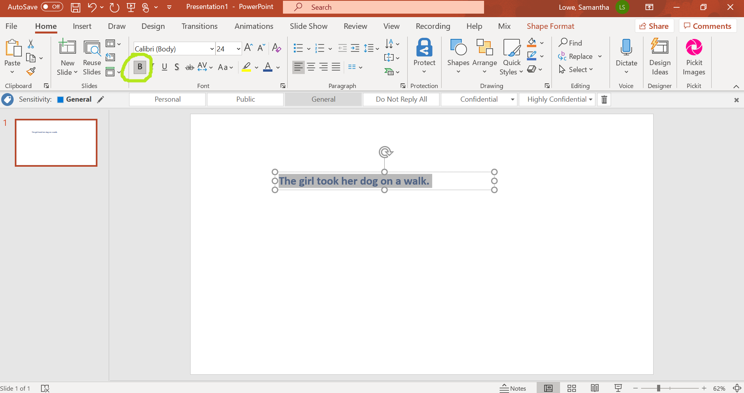
How to add Text
Make the font thicker by pressing the “Bold” button circled in the picture.

Slide 10
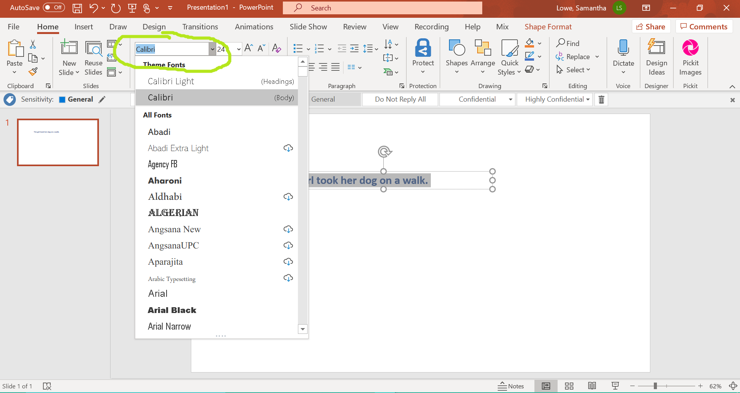
How to add Text
Change the font by pressing the arrow circled in the picture and choosing one from the list.

Slide 11
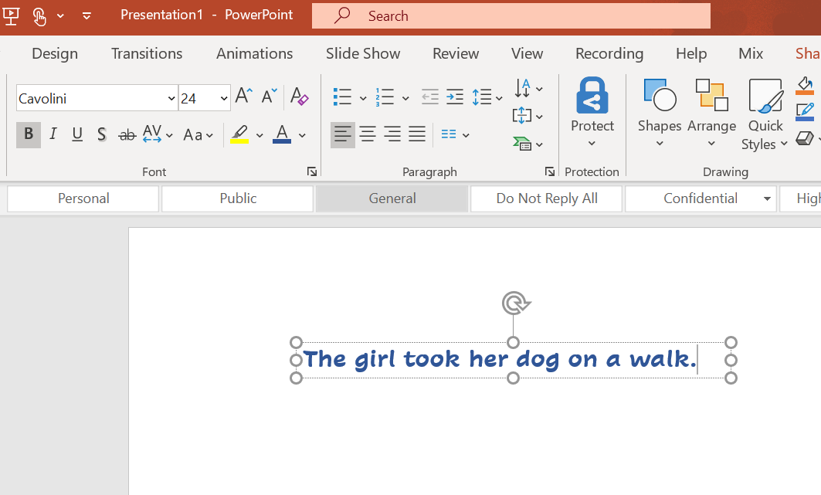
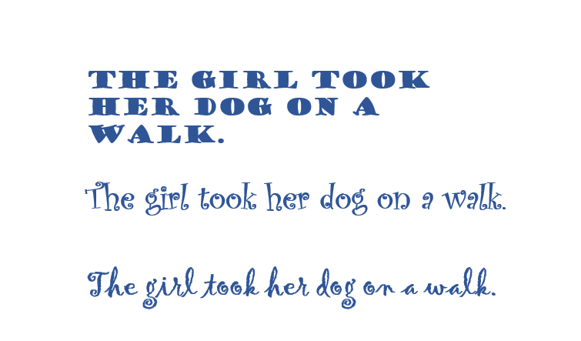
How to add Text
Make sure the text you choose is school appropriate and your teacher can read it!
This is okay! ☺ These are NOT okay… ☹

Slide 12
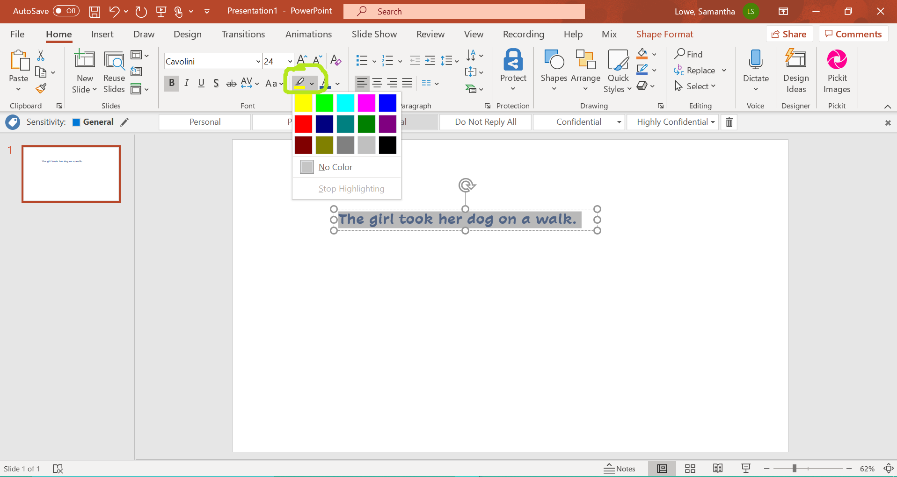
How to add Text
Highlight the words by clicking the highlighter and choosing a color.

Slide 13
Changing Text
Now you have the text you want! ☺

Slide 14
Adding a Picture
To add a picture, go back to the “Insert” tab at the top of the page.

Slide 15
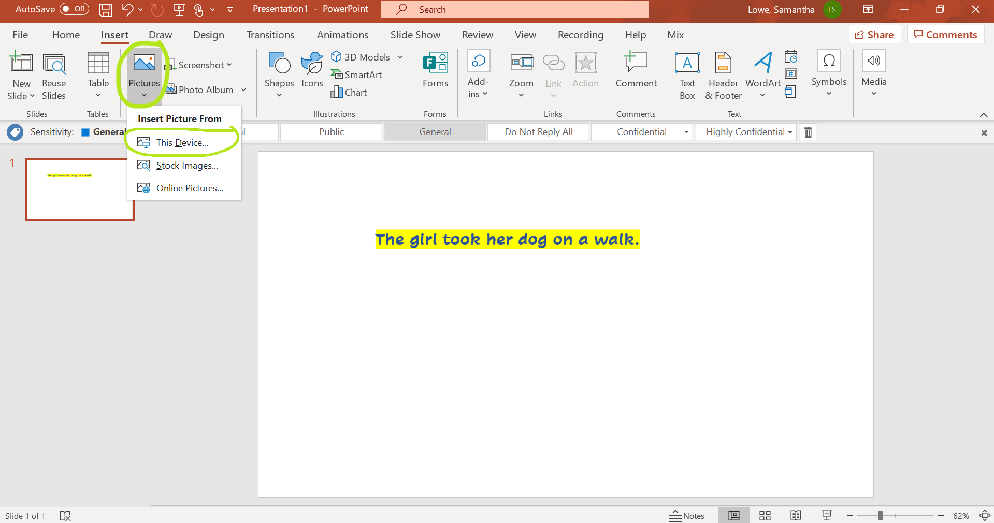
Adding a Picture
If you have a picture saved on your computer, choose “this device” to upload it.

Slide 16

Adding a Picture
If you need to search for a picture online, click “Online Pictures.”
It might also say “Bing Pictures” instead of “Online Pictures.”

Slide 17
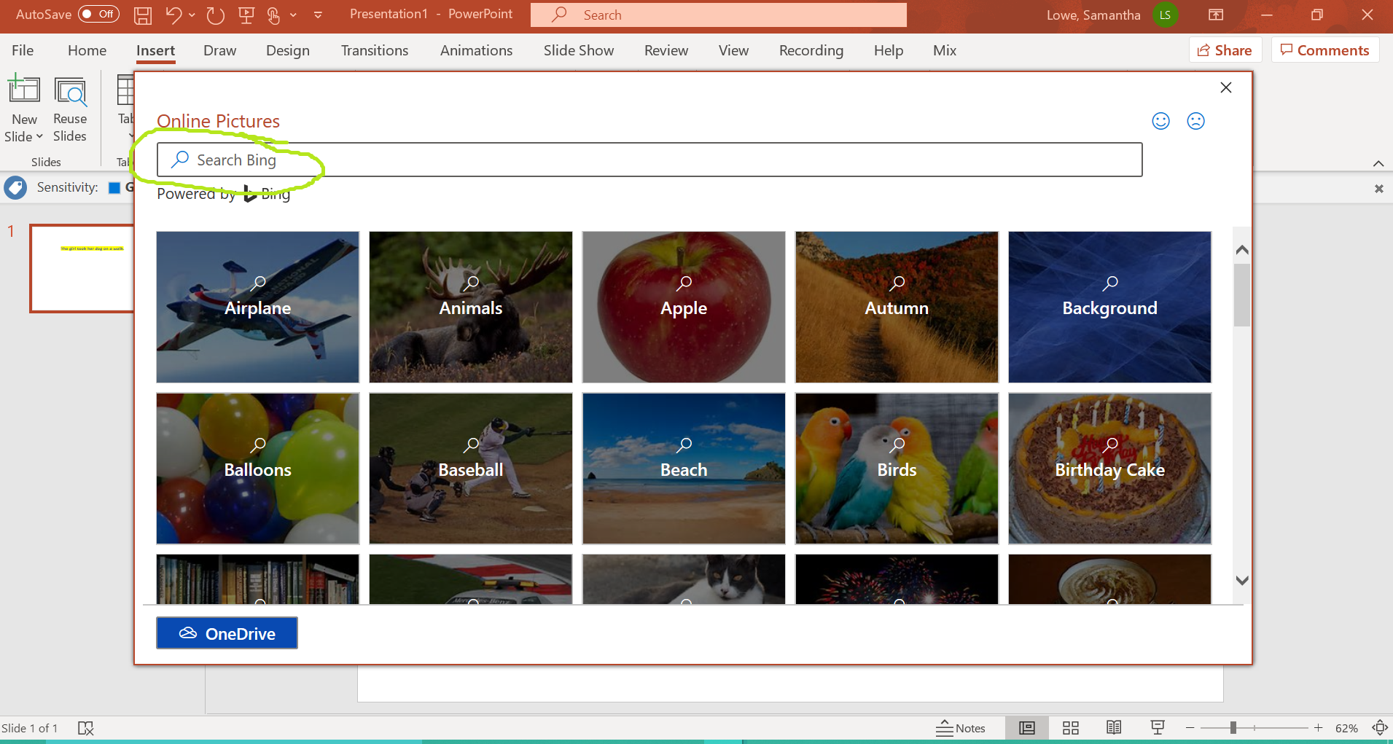
Adding a Picture
Type some key words in the “search” bar to find the picture you’re looking for.
You can’t be TOO specific or you might not get any results!

Slide 18
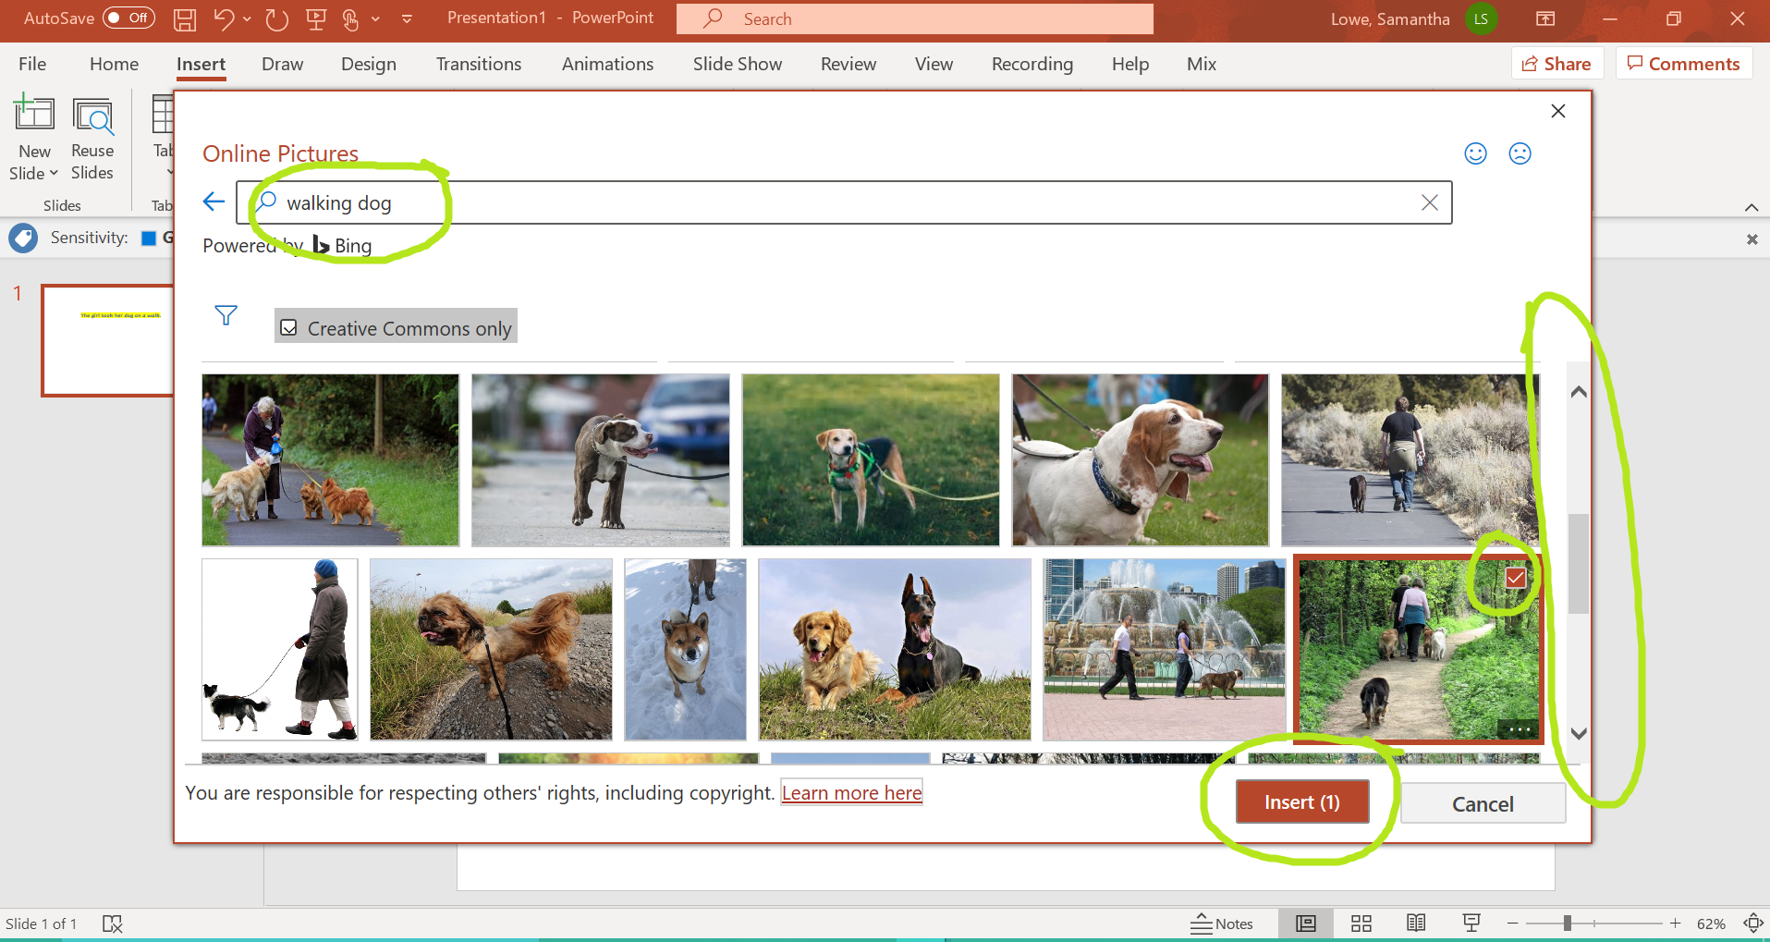
Adding a Picture
Select the image you want (scroll down to see more images) then click “Insert.”

Slide 19
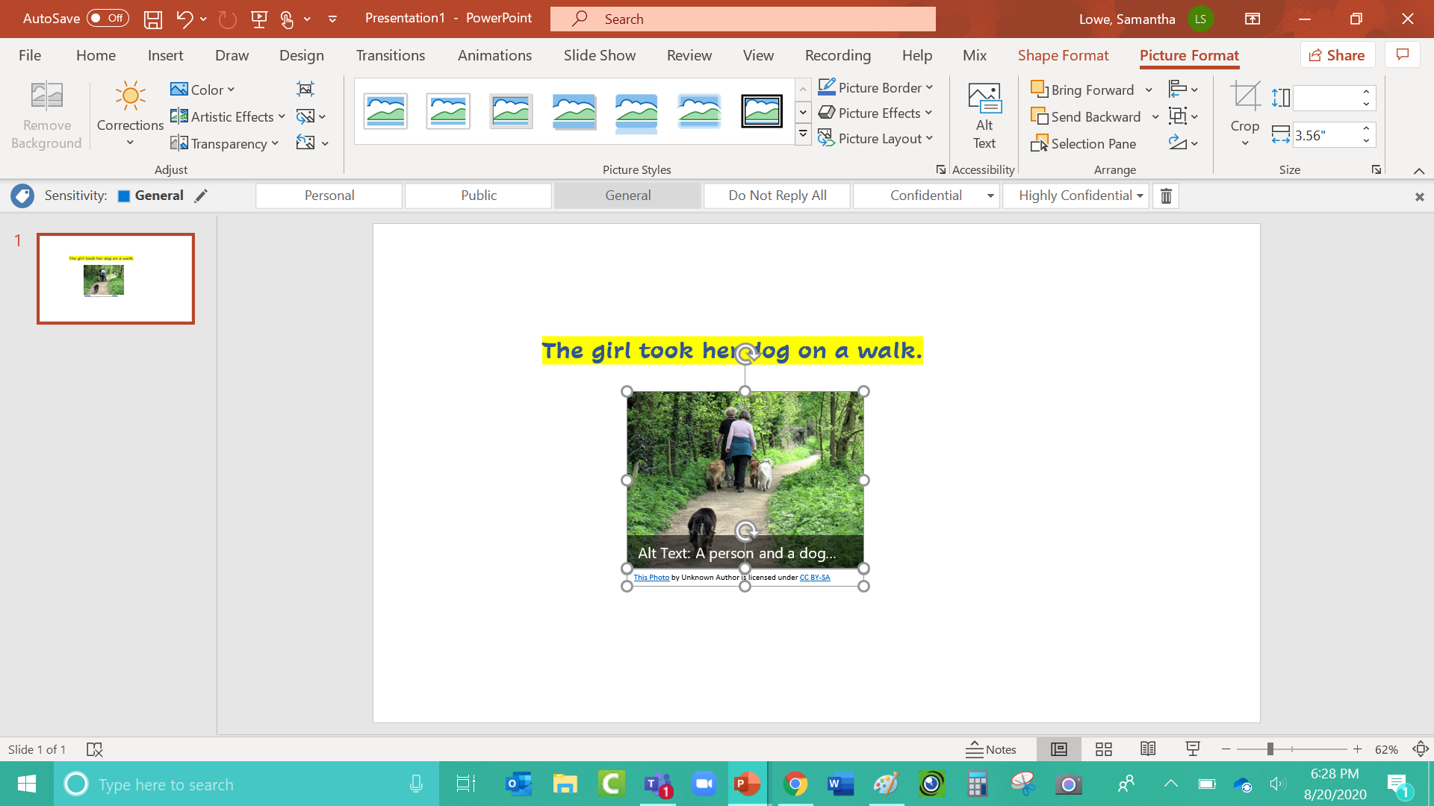
Adding a Picture
After your image is in the PowerPoint, drag the corners of the picture to make it bigger or smaller!

Slide 20
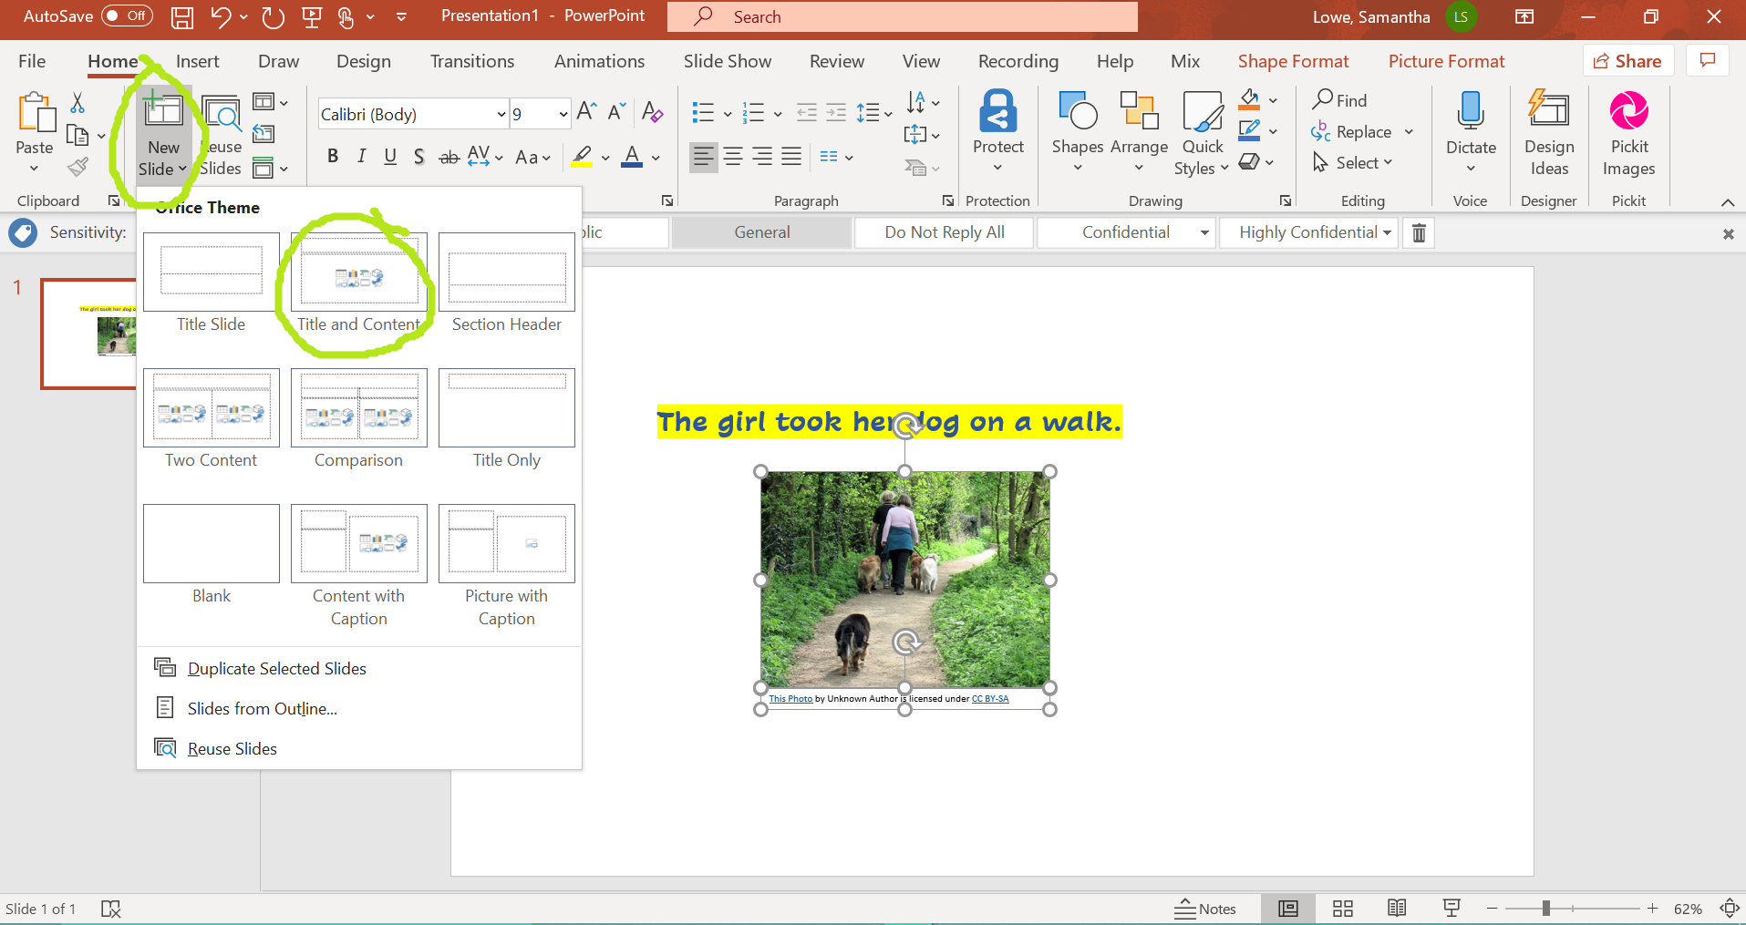
How to add a slide
Click “New Slide” and choose the type of slide you want to insert.

Slide 21
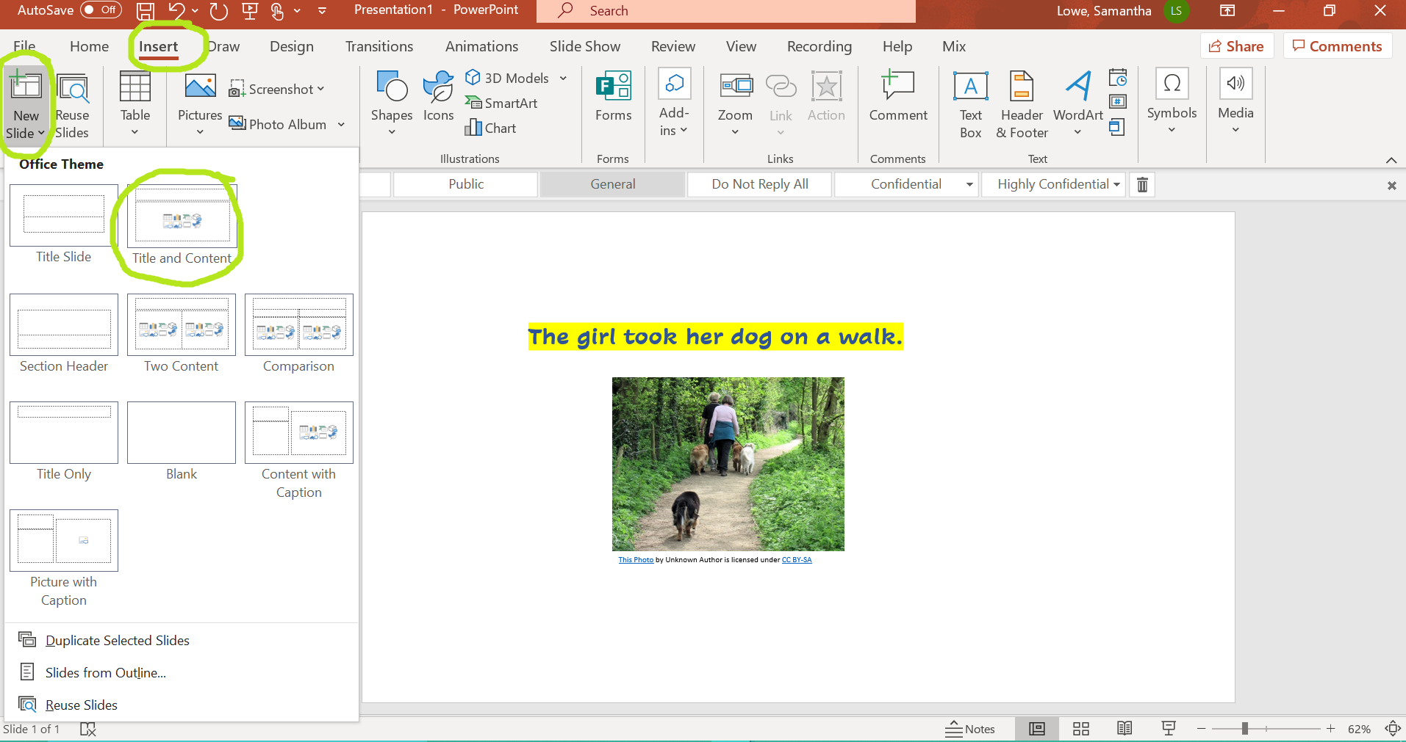
How to add a slide
OR click “Insert” then click “New Slide” and choose the slide you want.

Slide 22
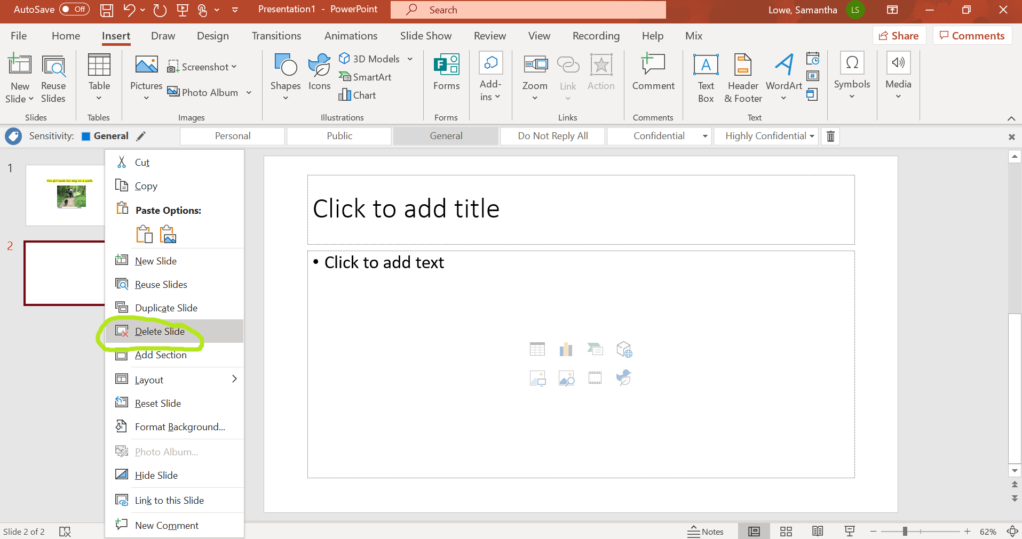
How to delete a slide
If you decide you don’t want that slide, hover your mouse over it, press the RIGHT side of the mouse, and choose “Delete Slide.”

Slide 23
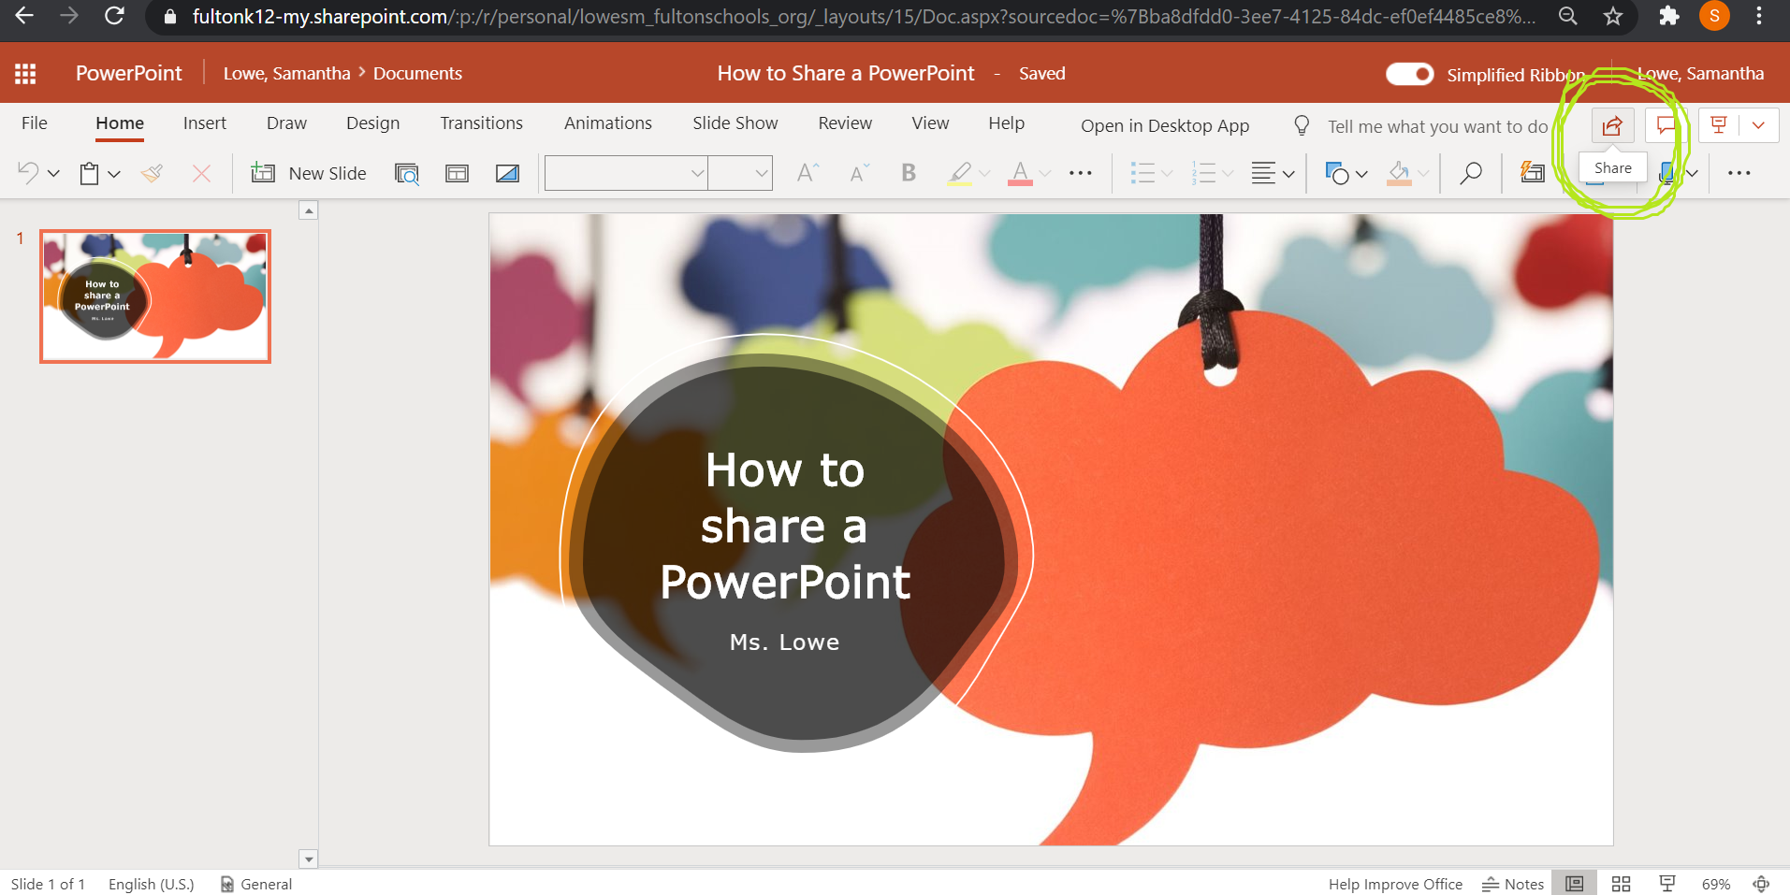
How to Share a PowerPoint with me
Click “Share” in the top right corner.

Slide 24
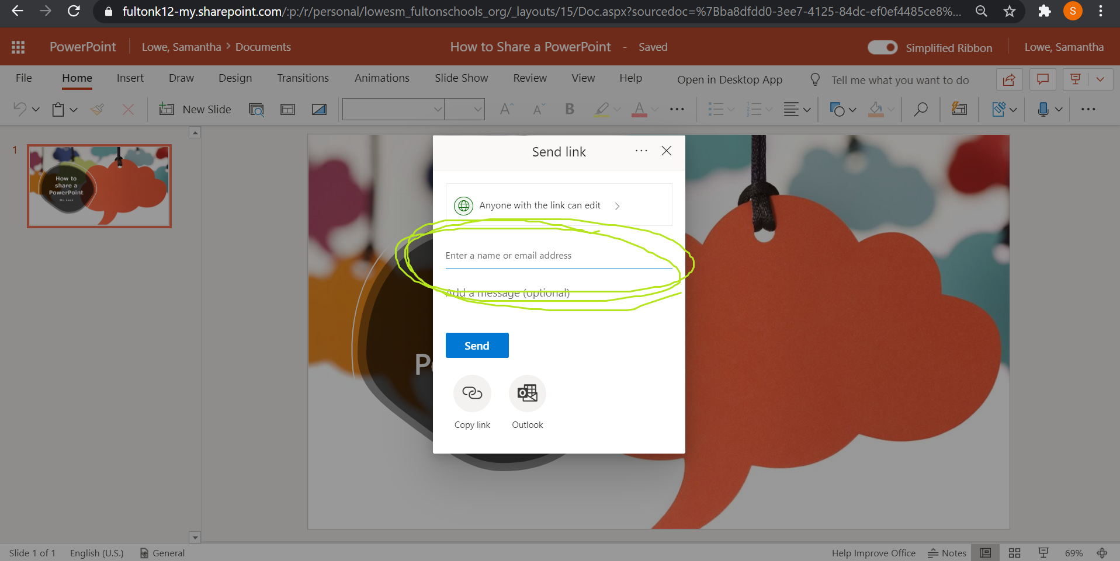
How to Share a PowerPoint with me
Click to enter an email.

Slide 25
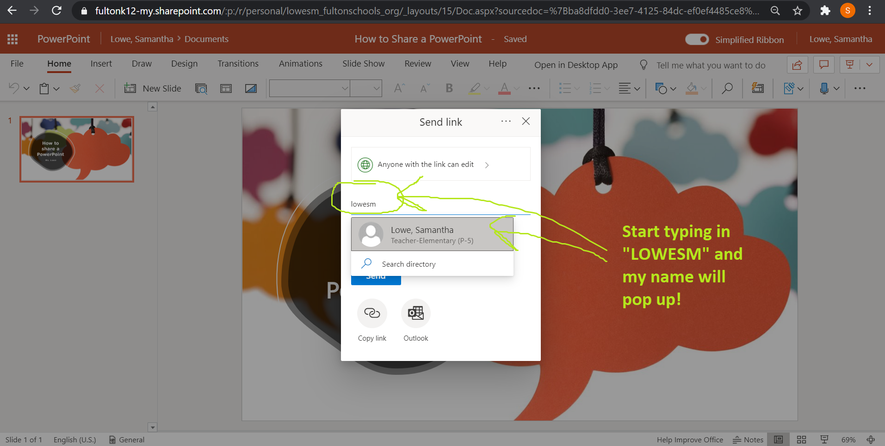
How to Share a PowerPoint with me
Type my last name followed by “sm” so it will be “lowesm” then click my name.

Slide 26
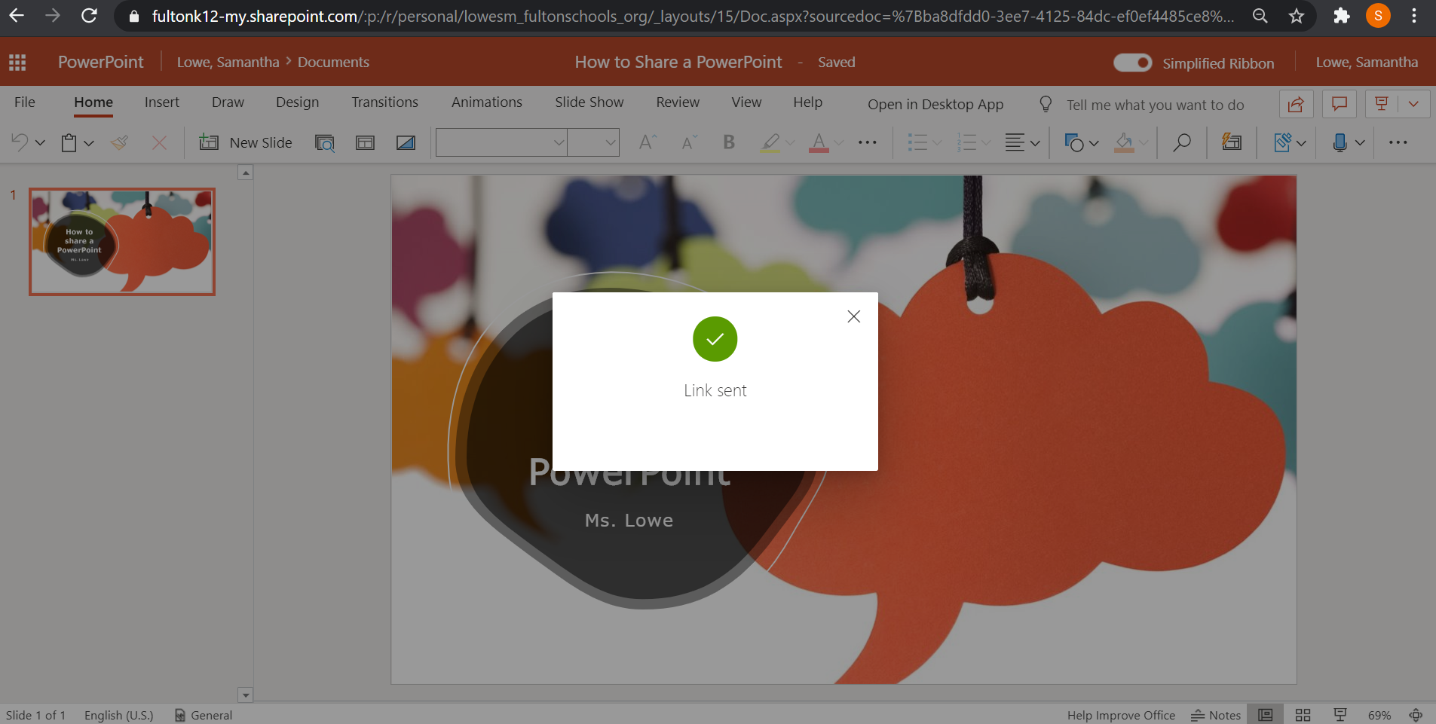
How to Share a PowerPoint with me
It will confirm that the link was sent to me! ☺

Slide 27
How to Share a PowerPoint with me
If you completed the PowerPoint in a Teams assignment, you do NOT need to share it with me! I can see it by clicking on your assignment. ☺

