Slide 1
How to use Gallopade
Ms. Lowe

Slide 2
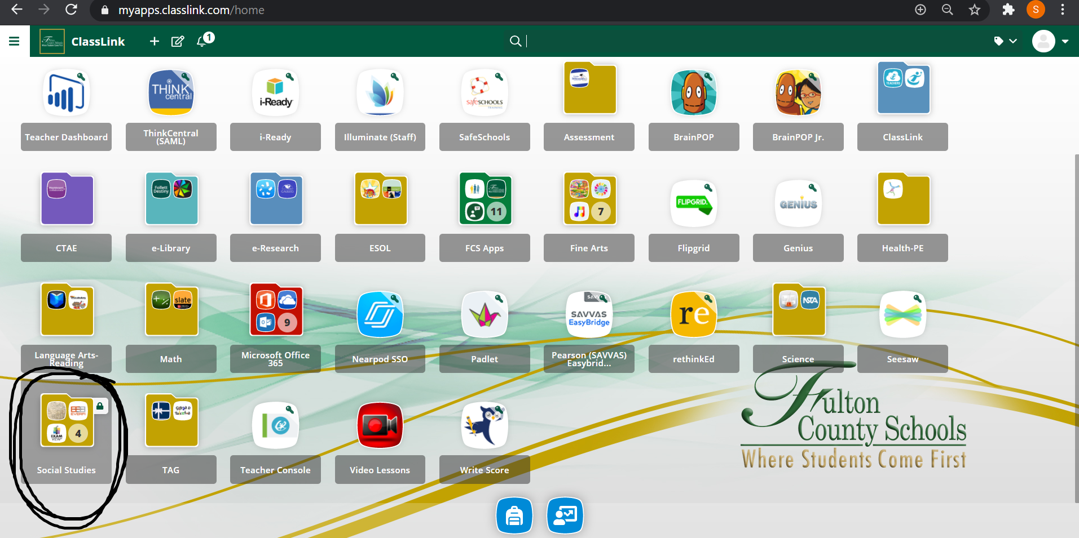
How to use Gallopade
Log into ClassLink and find the Social Studies folder.
You can also use the “Search” bar at the top of the page to search for Gallopade.

Slide 3
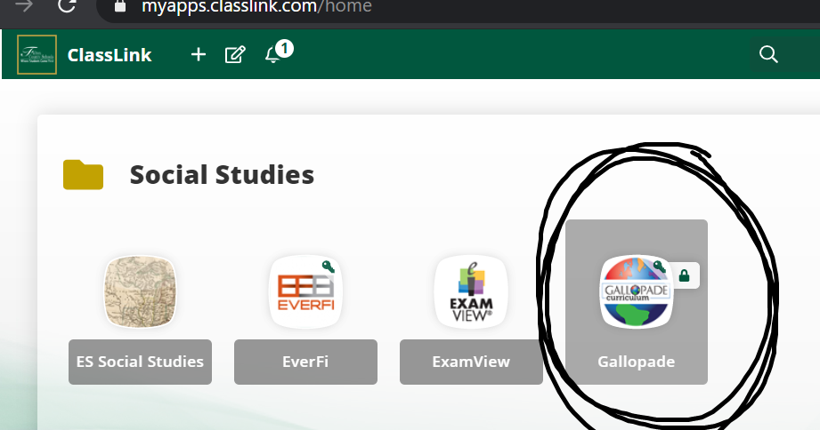
How to use Gallopade
When you open the folder, click “Gallopade.”

Slide 4
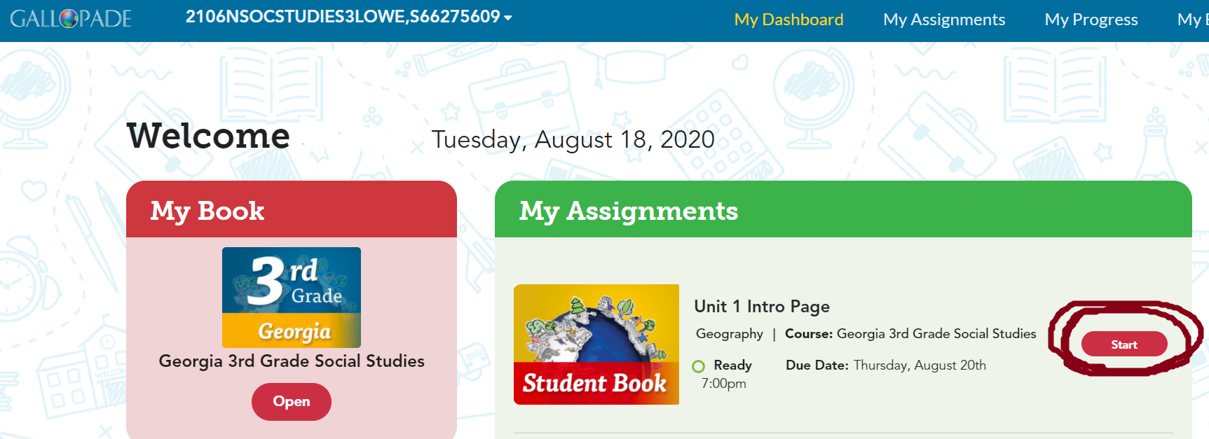
How to use Gallopade
You will see your online book in the red box on the left.
Your assignments will be in the green box on the right. Click “Start” to start an assignment.

Slide 5
How to use Gallopade
You can click “Student Instructions” at the top of the page to see the directions.
Click “Close” to close the assignment for now and finish it later.
Click “Submit” when you’re finished to turn the assignment in to your teacher.

Slide 6
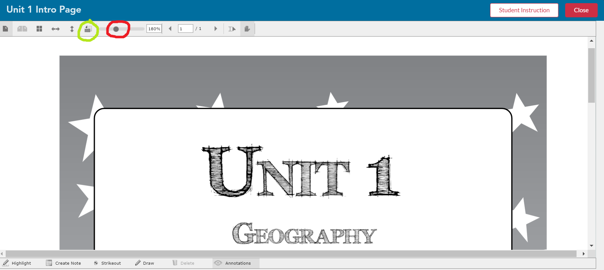
How to use Gallopade
Click the symbol circled in green to flip the page. You can click it more than once.
Click the symbol circled in red to zoom in and out. Hold your mouse on it and slide it to the left or the right.

Slide 7
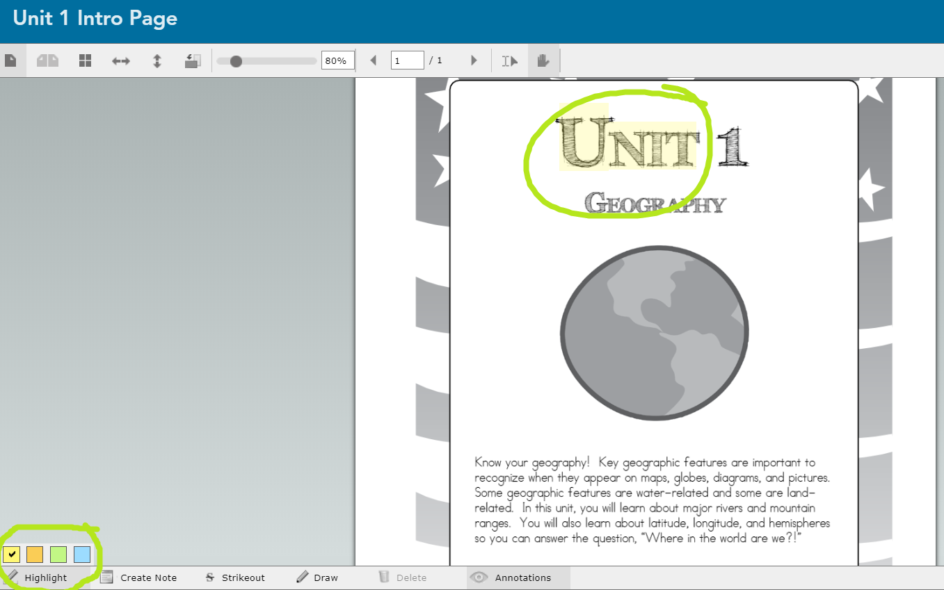
How to use Gallopade
Click the “Highlight” button at the bottom and choose the color you want to use.
Click at the beginning of the word, hold the mouse down, and drag your mouse over the word.
You can only highlight words, not pictures.

Slide 8
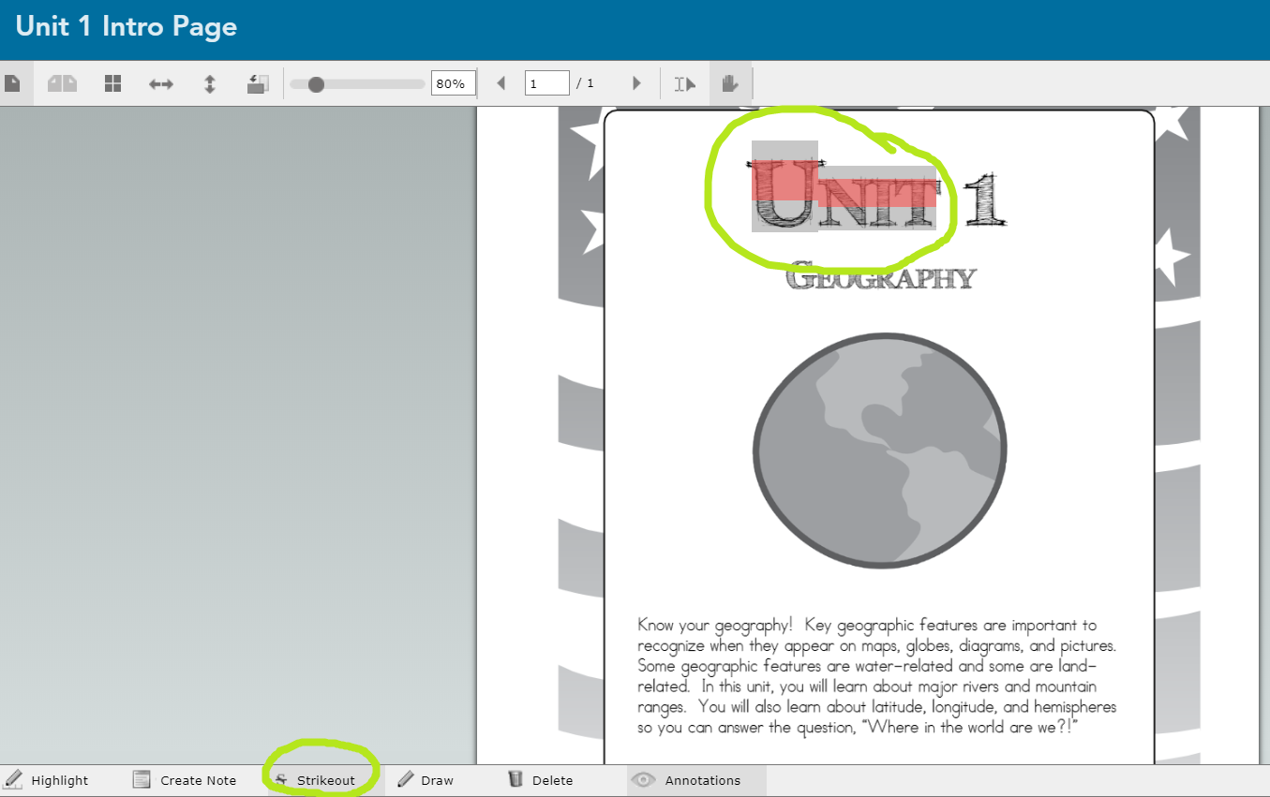
How to use Gallopade
Click the “Strikeout” button if you want to cross out a word.
Click the beginning of the word, hold the mouse down, and drag your mouse across the word to cross it out.

Slide 9
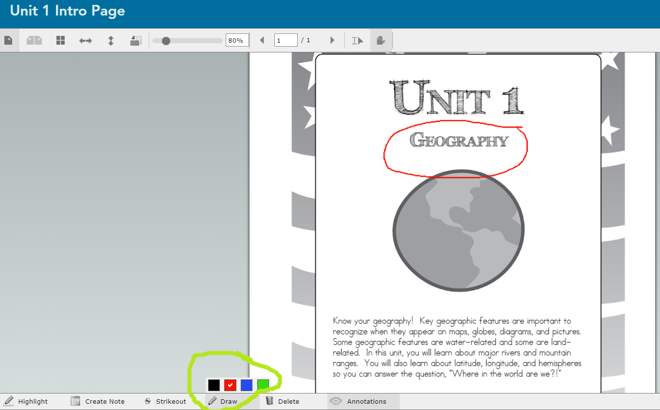
How to use Gallopade
To draw on the page, click “Draw” and choose the color you want to use.
Use your mouse to draw on the page.

Slide 10
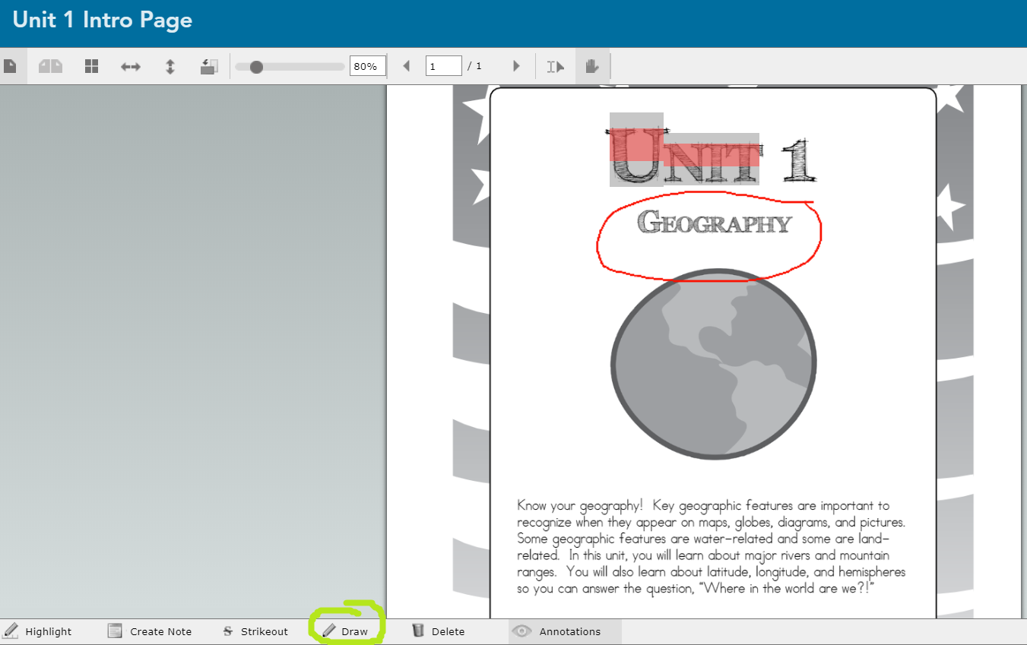
How to use Gallopade
After you draw, click “Draw” again to see your previous work.

Slide 11
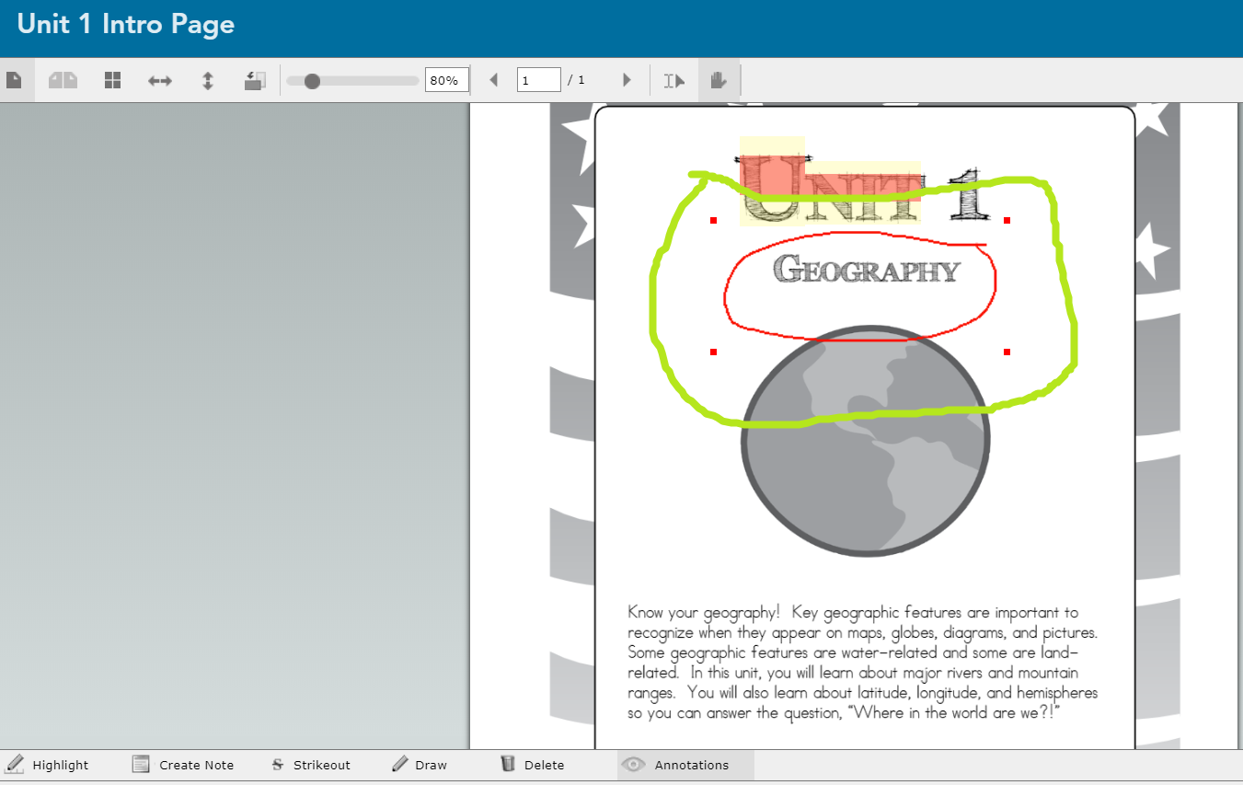
How to use Gallopade
To delete something you added to the page, click on the thing you want to delete.
Four dots will appear around the corners of the item.

Slide 12
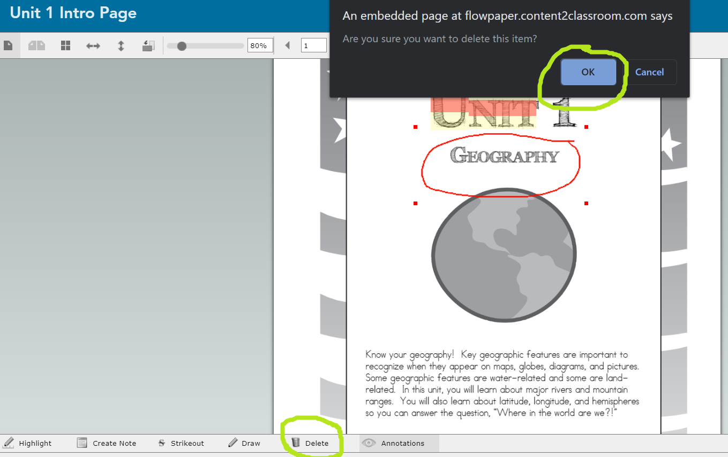
How to use Gallopade
When you click “Delete” at the bottom of the page, a box will appear asking you if you’re sure you want to delete the item. Click “OK.”

Slide 13
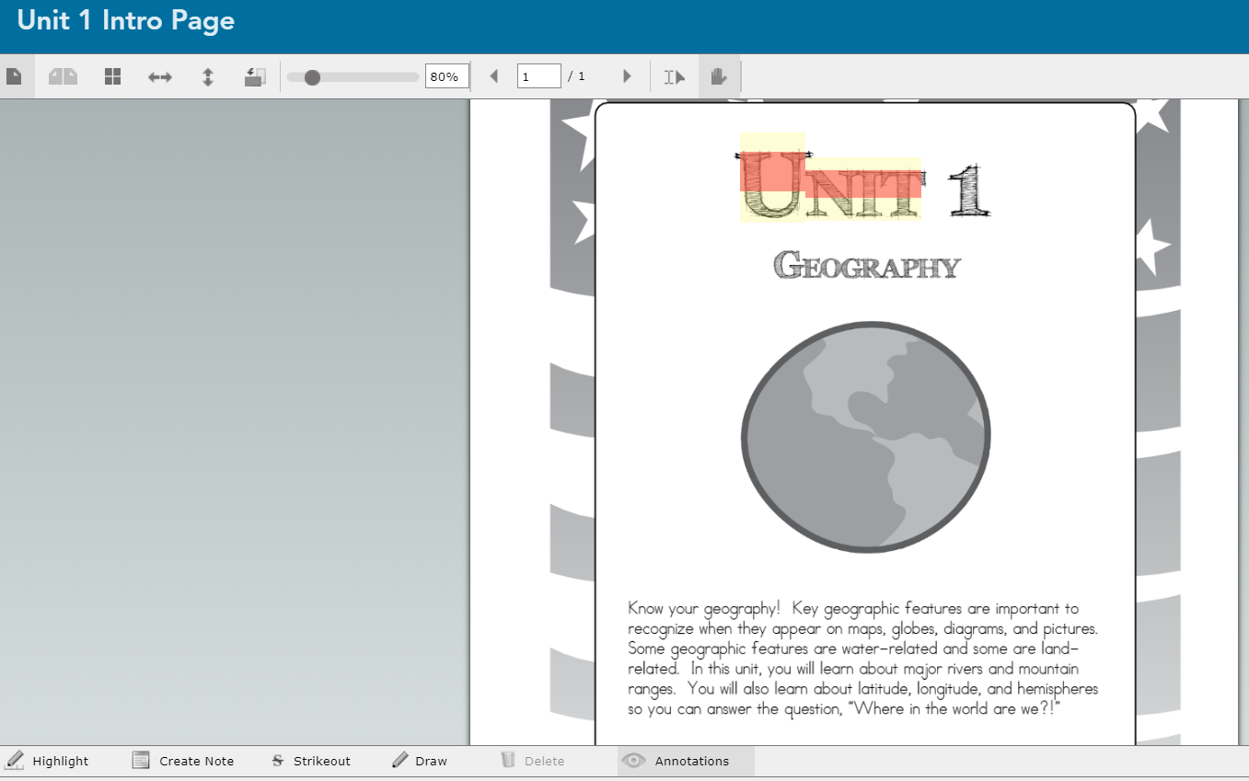
How to use Gallopade
Your item will be deleted! ☺

Slide 14
How to use Gallopade
Now that you know how to use Gallopade, go explore the app on your own! ☺
This Photo by Unknown Author is licensed under CC BY

